Slide 1
EE330 Final Project Autonomous Car
Xiaoyu Che & Dong Ding
12/7/2012

Slide 2
Outline
Objective
Design Method
Code For 3 Cases
Testbench And Simulation
Synthesis
Layout In Virtuoso

Slide 3
Objective
To Create a simple algorithm that is used when the software fails. This algorithm will be coded into hardware so that even when the main software fails, this backup emergency system will keep the car on the road until it can safely exit traffic and be repaired.

Slide 4
Design Method
Inputs:
· (2) Line sensors (2‐bit each)
· Camera Fail indicator
· GPS no signal indicator
· Software interrupt (software fail) indicator
· City vs. Highway mode
Outputs:
· Brakes - Assume a 4‐bit number scaled linearly with 0000 as 0% brakes and 1111 as 100% brakes.
· Accelerator (4‐bit)
· Wheel – Assume ‐90 degress to +90 degrees rotation (no major turns here) – this is scaled by an 8‐bit number.
· Alarm- for requesting human intervention

Slide 5
Code For Input, Output and Register
Mode : 1 city mode, 0 highway mode
X: Time register
Y: Brake indicator

Slide 6
Case 1: Highway Wheel Control
Case: Driving on a highway & software fails or when the GPS and/or cameras lose signal.
Condition:
1. The sensors return a 1 when a painted line in the road cross directly in front of the sensor from the right.
2. When the line comes from the left, a 2 is returned.
Result: The correct logic should turn the wheel for 2 seconds at a 45 degree angle from vertical in the correct direction to stay in the same lane.
Calculate :01000000 (64) means 45 degree left
11000000 (192) means 45 degree right

Slide 7
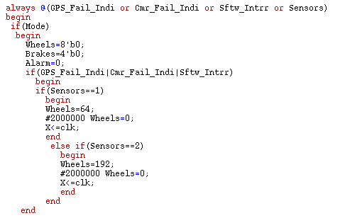
Code For Case 1
Normal position
Turn right
Turn left

Slide 8
Case 2: City Brake Control
Case: Driving in a city setting & the software fails or the cameras lose sight , a hardware backup is needed.
Result:
The car should slow to a stop immediately.
Slow the car by progressively increasing the brakes from 0% to 100% over 5 seconds. Hold brake at 100% until GPS/cameras return or the user takes over.
Alarm part integrated.
Calculate: 5 seconds, 4 bits– the brakes variable increase
16 times, 0.3125 seconds every time

Slide 9
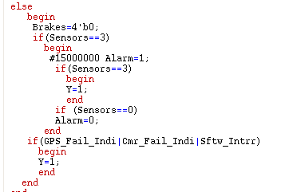
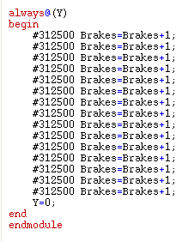
Code For Case 2
The sensors don't operate after 15 seconds, the car stops
A human takes control.
The alarm will be off.
Brakes indicator = 1, start brake
Increasing the brakes
from 0% to 100% over 5 seconds

Slide 10
Case 3: Worst Case
The worst case: the software fails or the cameras lose sight , a hardware backup is needed. And even the backup sensors lose signal
Condition:
1. After 15 seconds, if the sensors do not resume operation, the car will be slowed to a stop no matter on the highway or city.
2. If a human takes control in 15 seconds, the alarm will be off.

Slide 11
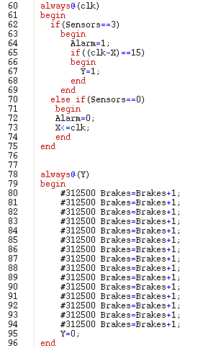
Code For Case 3
Brakes when the alarm keeps 15s
A human takes control. Sensor=0.
The alarm will be off.
Increasing the brakes
from 0% to 100% over 5 seconds

Slide 12
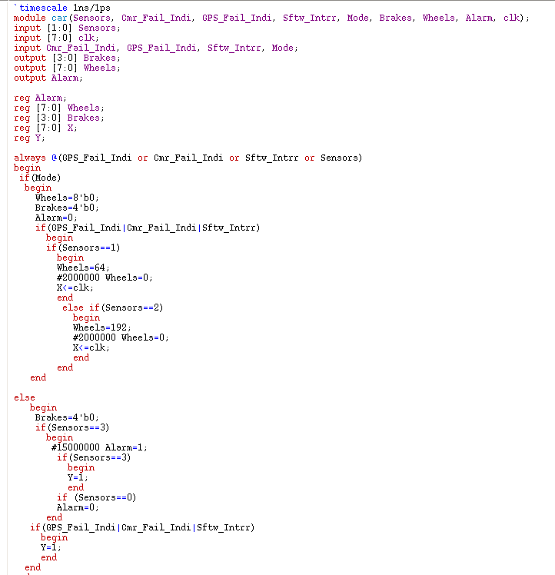
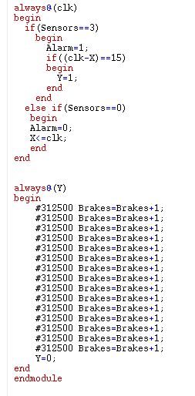
Overall Code:
Input output
and register
Case1:
wheel control
increasing brakes
from 0% to 100%
over 5 seconds
Case2:
City brake control

Slide 13
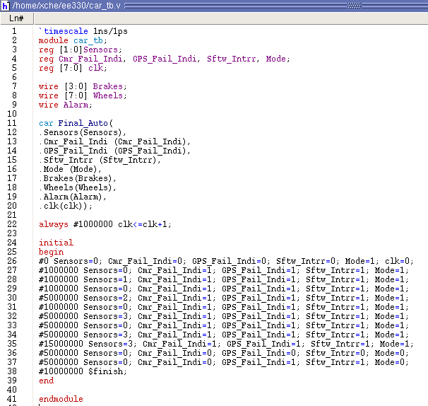
Testbench And Simulation
The testbench is as follow:

Slide 14
Case 1: Highway Wheel Control
Result:
When sensor=1(01), which means the car turns right. Wheel=01000000 to correct the direction.
Otherwise, When sensor=2(10), Wheel=11000000.

Slide 15
Case 2: City Brake Control
Result:
Slow the car by progressively increasing the brakes from 0% to 100% over 5 seconds. Hold brake at 100% until GPS/cameras return or the user takes over.

Slide 16
Case 3: worst case
Result:
After 15 seconds, if the sensors resume operation , the alarm will be 0 again. If they do not resume operation, the car will be slowed to a stop no matter on the highway or city.

Slide 17
Synthesis

Slide 18
Floorplanning

Slide 19
Power Planning

Slide 20
Placement

Slide 21
Special Route

Slide 22
Nano Route

Slide 24
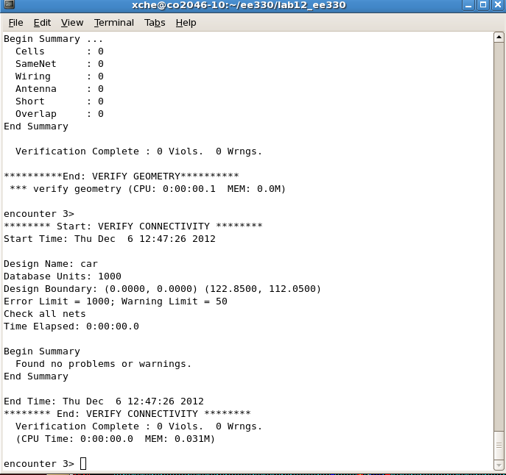
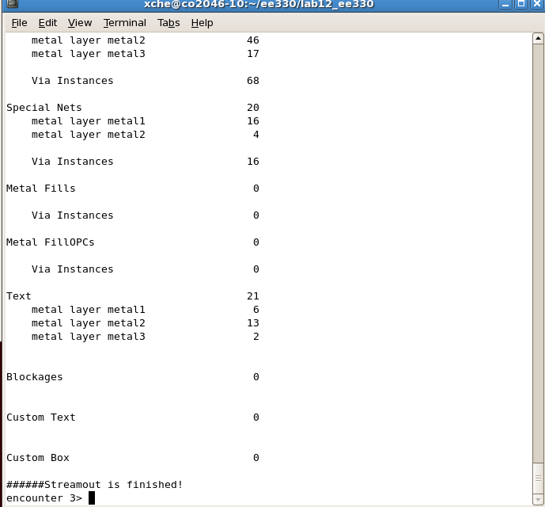
Verification & Streamout

Slide 25
Layout In Virtuoso

Slide 26
Thank you!

